Slide 1

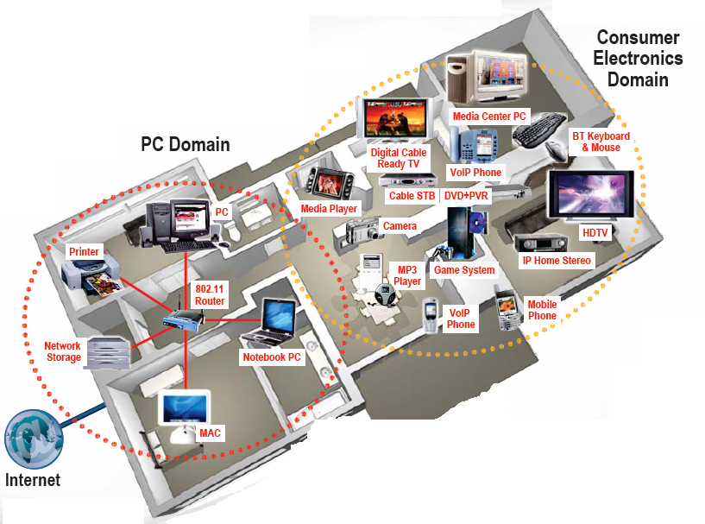




Wireless Communication Engineering

Slide 2
Outline
Course Basics
Course Syllabus
The Wireless Vision
Technical Challenges
Current Wireless Systems
Emerging Wireless Systems
Spectrum Regulation
Standards

Slide 3
Course Information
Nuts and Bolts
Instructors: Xin Wang, xwang11@fudan.edu.cn;
Yu Zhu, zhuyu@fudan.edu.cn.
Required Textbook: Andrea Goldsmith, Wireless Communications, Cambridge University Press, 2005
Grading: Attendance 10%， Examination 90%
HWs: take-home, not graded, a good preparation for exam.

Slide 4
Course Syllabus
Overview of Wireless Communications
Path Loss, Shadowing, and Fading Models
Capacity of Wireless Channels
Digital Modulation and its Performance
Diversity
Channel Coding
MIMO Systems
Equalization
Multicarrier Modulation

Slide 5
Wireless History
Ancient Systems: Smoke Signals, Carrier Pigeons, …
Radio invented in the 1880s by Marconi
Many sophisticated military radio systems were developed during and after WW2
Cellular has enjoyed exponential growth since 1988, with almost 3 billion users worldwide today
  Ignited the wireless revolution
  Voice, data, and multimedia becoming ubiquitous
  Use in third world countries growing rapidly
Wifi also enjoying tremendous success and growth
  Wide area networks (e.g. Wimax) and short-range systems other than Bluetooth (e.g. UWB) less successful

Slide 6

Future Wireless Networks
Ubiquitous Communication Among People and Devices
Next-generation Cellular
Wireless Internet Access
Wireless Multimedia
Sensor Networks
Smart Homes/Spaces
Automated Highways
In-Body Networks
All this and more …

Slide 7
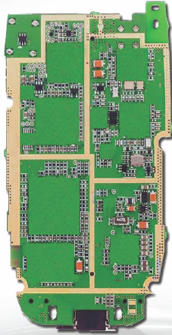
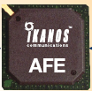
Challenges
Network Challenges
  Scarce spectrum
  Demanding/diverse applications
  Reliability
  Ubiquitous coverage
  Seamless indoor/outdoor operation
Device Challenges
  Size, Power, Cost
  Multiple Antennas in Silicon
  Multiradio Integration
  Coexistance
BT
FM/XM
GPS
Cellular
DVB-H
Apps
Processor
WLAN
Media
Processor
Wimax

Slide 8
Evolution of Current Systems
Wireless systems today
  3G Cellular: ~200-300 Kbps.
  WLANs: ~450 Mbps (and growing).
Next Generation is in the works
  4G Cellular: Likely OFDM/MIMO
  4G WLANs: Wide open, 3G just being finalized
Technology Enhancements
  Hardware: Better batteries. Better circuits/processors.
  Link: Antennas, modulation, coding, adaptivity, DSP, BW.
  Network: Not much: more efficient resource allocation
  Application: Soft and adaptive QoS.

Slide 9
Future Generations
Other Tradeoffs:
Rate vs. Coverage
Rate vs. Delay
Rate vs. Cost
Rate vs. Energy
Rate
802.11n
4G
802.11b WLAN
3G
2G
Wimax/3G
2G Cellular
Mobility
Fundamental Design Breakthroughs Needed
Notes:
-Diminishing returns by beating on the same areas for optimization
-Other network tradeoffs not even considered
-Fundamental breakthroughs both in the way wireless networks are designed and in the design tradeoffs that are considered.

Slide 10
Multimedia Requirements
Voice
Data
Video
Delay
<100ms
-
<100ms
Packet Loss
<1%
0
<1%
BER
10⁻³
10⁻⁶
10⁻⁶
Data Rate
8-32 Kbps
10-1000 Mbps
10-1000 Mbps
Traffic
Continuous
Bursty
Continuous
One-size-fits-all protocols and design do not work well
Wired networks use this approach, with poor results

Slide 11
Quality-of-Service (QoS)
QoS refers to the requirements associated with a given application, typically rate and delay requirements.
It is hard to make a one-size-fits all network that supports requirements of different applications.
Wired networks often use this approach with poor results, and they have much higher data rates and better reliability than wireless.
QoS for all applications requires a cross-layer design approach.

Slide 12
Crosslayer Design
Application
Network
Access
Link
Hardware
Delay Constraints
Rate Constraints
Energy Constraints
Adapt across design layers
Reduce uncertainty through scheduling
Provide robustness via diversity

Slide 13
Current Wireless Systems
Cellular Systems
Wireless LANs
WIMAX
Satellite Systems
Paging Systems
Bluetooth
Ultrawideband radios
Zigbee radios

Slide 14
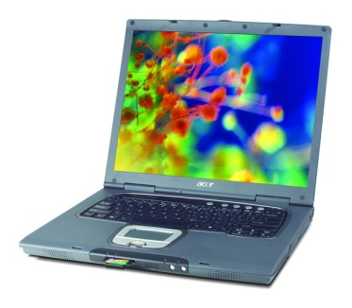
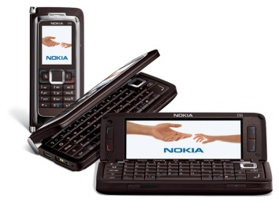
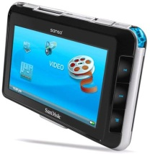
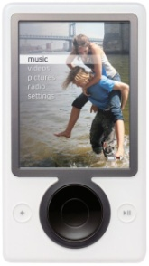
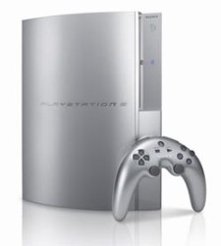
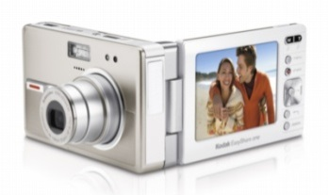
Cellular Phones
Everything Wireless in One Device

Slide 15
Cellular Systems:
Reuse channels to maximize capacity
Geographic region divided into cells
Frequency/timeslots/codes/ reused at spatially-separated locations.
Co-channel interference between same color cells.
Base stations/MTSOs coordinate handoff and control functions
Shrinking cell size increases capacity, as well as networking burden
BASE
STATION
MTSO

Slide 16
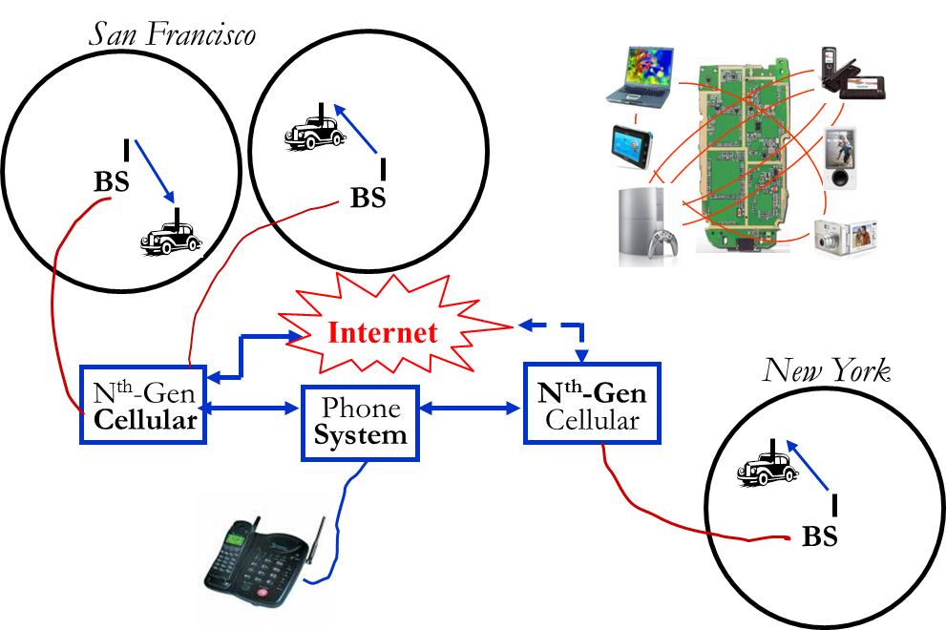
Cellular Networks
Future networks want better performance and reliability
- Gbps rates, low latency, 99% coverage indoors and out

Slide 17
3G Cellular Design:
Voice and Data
Data is bursty, whereas voice is continuous
  Typically require different access and routing strategies
3G “widens the data pipe”:
  384 Kbps (802.11n has 100s of Mbps).
  Standard based on wideband CDMA
  Packet-based switching for both voice and data
  3G cellular popular in Asia and Europe
Evolution of existing systems in US (2.5G++)
    GSM+EDGE, IS-95(CDMA)+HDR
    100 Kbps may be enough
    Dual phone (2/3G+Wifi) use growing (iPhone, Google)
What is beyond 3G?
The trillion dollar question

Slide 18
4G and LTE
(long term evolution)
OFDM/MIMO
Much higher data rates (50-100 Mbps)
Greater spectral efficiency (bits/s/Hz)
Flexible use of up to 100 MHz of spectrum
Low packet latency (<5ms).
Increased system capacity
Reduced cost-per-bit
Support for multimedia

Slide 19
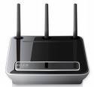


Wifi Networks
Multimedia Everywhere, Without Wires
802.11n++
Streaming video
Gbps data rates
High reliability
Coverage in every room
Wireless HDTV
and Gaming

Slide 20

Wireless Local Area Networks (WLANs)
01011011
0101
1011
Internet
Access
Point
WLANs connect “local” computers (100m range)
Breaks data into packets
Channel access is shared (random access)
Backbone Internet provides best-effort service
  Poor performance in some apps (e.g. video)

Slide 21
Wireless LAN Standards
802.11b (Old – 1990s)
  Standard for 2.4GHz ISM band (80 MHz)
  Direct sequence spread spectrum (DSSS)
  Speeds of 11 Mbps, approx. 500 ft range
802.11a/g (Middle Age– mid-late 1990s)
  Standard for 5GHz NII band (300 MHz)
  OFDM in 20 MHz with adaptive rate/codes
  Speeds of 54 Mbps, approx. 100-200 ft range
802.11n (Hot stuff, standard done, published in Oct)
  Standard in 2.4 GHz and 5 GHzband
  Adaptive OFDM /MIMO in 20/40 MHz (2-4 antennas)
  Speeds up to 600Mbps, approx. 200 ft range
  Other advances in packetization, antenna use, etc.
Many WLAN
cards have
all 3 (a/b/g)

Slide 22
Wimax (802.16)
Wide area wireless network standard
  System architecture similar to cellular
  Hopes to compete with cellular
OFDM/MIMO is core link technology
Operates in 2.5 and 3.5 MHz bands
  Different for different countries, 5.8 also used.
  Bandwidth is 3.5-10 MHz
Fixed (802.16d) vs. Mobile (802.16e) Wimax
  Fixed: 75 Mbps max, up to 50 mile cell radius
  Mobile: 15 Mbps max, up to 1-2 mile cell radius

Slide 23


Satellite Systems
Cover very large areas
Different orbit heights
  GEOs (39000 Km) versus LEOs (2000 Km)
Optimized for one-way transmission
  Radio (XM, Sirius) and movie (SatTV, DVB/S) broadcasts
  Most two-way systems struggling or bankrupt
Global Positioning System (GPS) use growing
  Satellite signals used to pinpoint location
  Popular in cell phones, PDAs, and navigation devices

Slide 24

Paging Systems
Broad coverage for short messaging
Message broadcast from all base stations
Simple terminals
Optimized for 1-way transmission
Answer-back hard
Overtaken by cellular

Slide 25
Bluetooth
Cable replacement RF technology (low cost)
Short range (10m, extendable to 100m)
2.4 GHz band (crowded)
1 Data (700 Kbps) and 3 voice channels, up to 3 Mbps
Widely supported by telecommunications, PC, and consumer electronics companies
Few applications beyond cable replacement
8C32810.61-Cimini-7/98

Slide 26
Ultrawideband Radio (UWB)
UWB is an impulse radio: sends pulses of tens of picoseconds(10⁻¹²) to nanoseconds (10⁻⁹)
  Duty cycle of only a fraction of a percent
A carrier is not necessarily needed
Uses a lot of bandwidth (GHz)
High data rates, up to 500 Mbps
7.5 Ghz of “free spectrum” in the U.S. (underlay)
Multipath highly resolvable: good and bad
Limited commercial success to date

Slide 27
IEEE 802.15.4 / ZigBee Radios
Low-Rate WPAN
Data rates of 20, 40, 250 Kbps
Support for large mesh networking or star clusters
Support for low latency devices
CSMA-CA channel access
Very low power consumption
Frequency of operation in ISM bands
Focus is primarily on low power sensor networks

Slide 28
Tradeoffs
802.11n
3G
Rate
802.11g/a
Power
802.11b
UWB
Bluetooth
ZigBee
Range

Slide 29
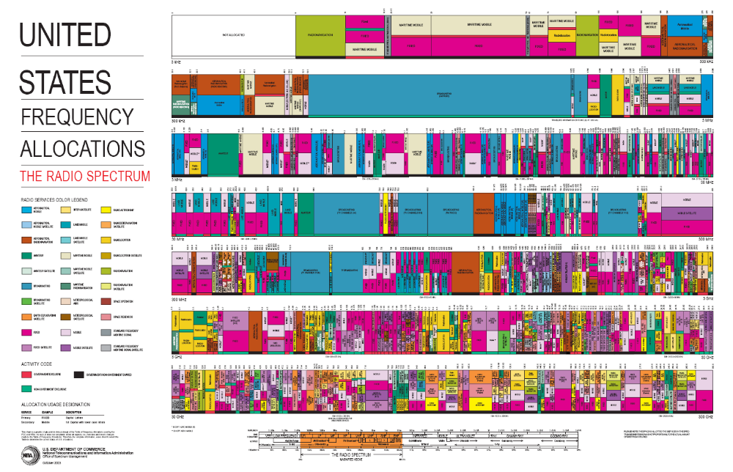
Scarce Wireless Spectrum
$$$
and Expensive

Slide 30
Spectrum Regulation
Spectral Allocation in US controlled by FCC (commercial) or OSM (defense)
FCC auctions spectral blocks for set applications.
Some spectrum set aside for universal use
Worldwide spectrum controlled by ITU-R
Regulation is a necessary evil.
Innovations in regulation being considered worldwide, including underlays, overlays, and cognitive radios

Slide 31

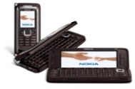
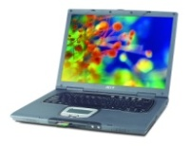
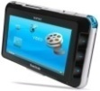
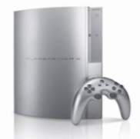

Spectral Reuse
Due to its scarcity, spectrum is reused
In licensed bands
and unlicensed bands
BS
Cellular, Wimax
Wifi, BT, UWB,…
Reuse introduces interference

Slide 32

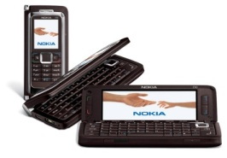
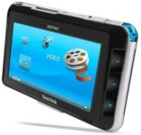
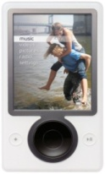

Need Better Coexistence
Many devices use the same radio band
Technical Solutions:
  Interference Cancellation
  Smart/Cognitive Radios

Slide 33
Standards
Interacting systems require standardization
Companies want their systems adopted as standard
  Alternatively try for de-facto standards
Standards determined by TIA/CTIA in US
  IEEE standards often adopted
  Process fraught with inefficiencies and conflicts
Worldwide standards determined by ITU-T
  In Europe, ETSI is equivalent of IEEE
Standards for current systems are summarized in Appendix D.

Slide 34
Emerging Systems*
4th generation cellular (4G)
  OFDMA will be PHY layer (like Wimax)
  Other new features and bandwidth still in flux
Ad hoc/mesh wireless networks
Cognitive radios
Sensor networks
Distributed control networks
Biomedical networks

Slide 35
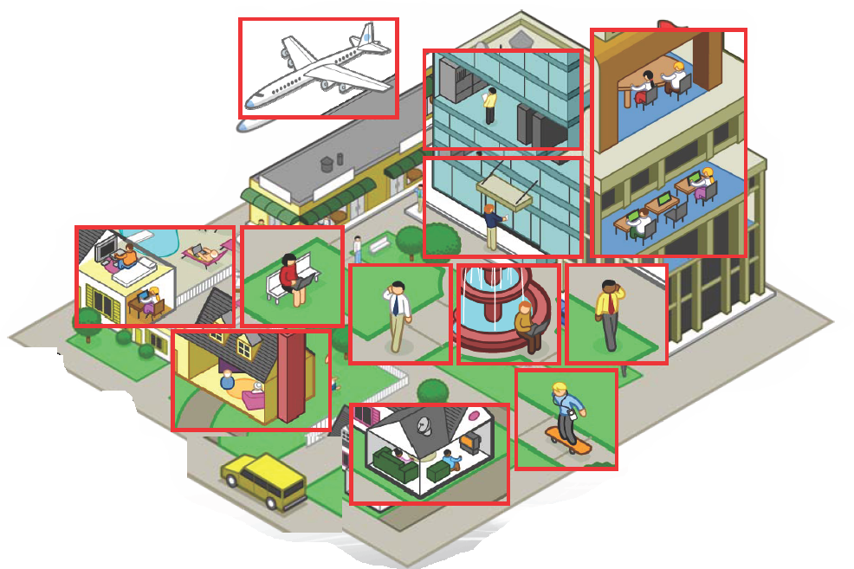
Ad-Hoc/Mesh Networks
ce
Outdoor Mesh
Indoor Mesh

Slide 36
Design Issues
Ad-hoc networks provide a flexible network infrastructure for many emerging applications.
The capacity of such networks is generally unknown.
Transmission, access, and routing strategies for ad-hoc networks are generally ad-hoc.
Crosslayer design critical and very challenging.
Energy constraints impose interesting design tradeoffs for communication and networking.

Slide 37
Cognitive Radio Paradigms
Underlay
  Cognitive radios constrained to cause minimal interference to noncognitive radios
Interweave
  Cognitive radios find and exploit spectral holes to avoid interfering with noncognitive radios
Overlay
  Cognitive radios overhear and enhance noncognitive radio transmissions
Knowledge
and
Complexity

Slide 38
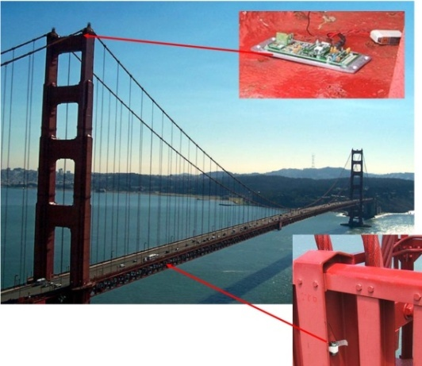
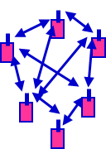
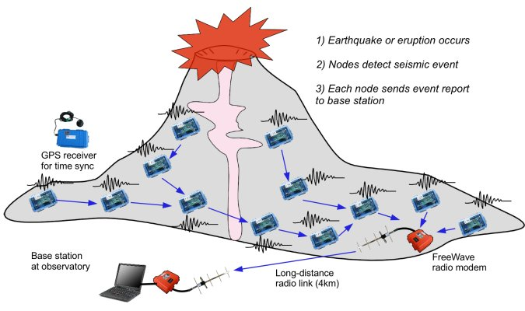
Wireless Sensor Networks
Data Collection and Distributed Control
Smart homes/buildings
Smart structures
Search and rescue
Homeland security
Event detection
Battlefield surveillance
Energy (transmit and processing) is the driving constraint
Data flows to centralized location (joint compression)
Low per-node rates but tens to thousands of nodes
Intelligence is in the network rather than in the devices

Slide 39
Energy-Constrained Nodes
Each node can only send a finite number of bits.
  Transmit energy minimized by maximizing bit time
  Circuit energy consumption increases with bit time
  Introduces a delay versus energy tradeoff for each bit
Short-range networks must consider transmit, circuit, and processing energy.
  Sophisticated techniques not necessarily energy-efficient.
  Sleep modes save energy but complicate networking.
Changes everything about the network design:
  Bit allocation must be optimized across all protocols.
  Delay vs. throughput vs. node/network lifetime tradeoffs.
  Optimization of node cooperation.
Notes:
All the sophisticated high-performance communication techniques developed since WW2 may need to be thrown out the window.
By cooperating, nodes can save energy

Slide 40

Distributed Control over Wireless
Automated Vehicles
- Cars
- Airplanes/UAVs
- Insect flyers
  Interdisciplinary design approach
    Control requires fast, accurate, and reliable feedback.
    Wireless networks introduce delay and loss
    Need reliable networks and robust controllers
    Mostly open problems
: Many design challenges

Slide 41
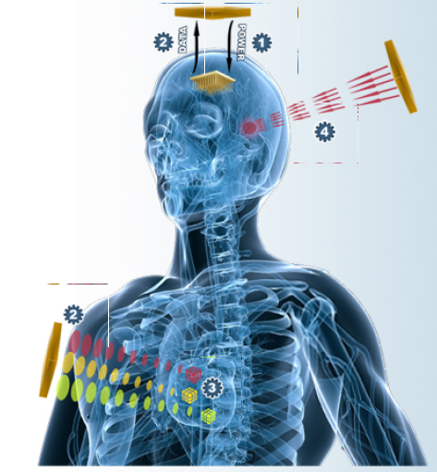
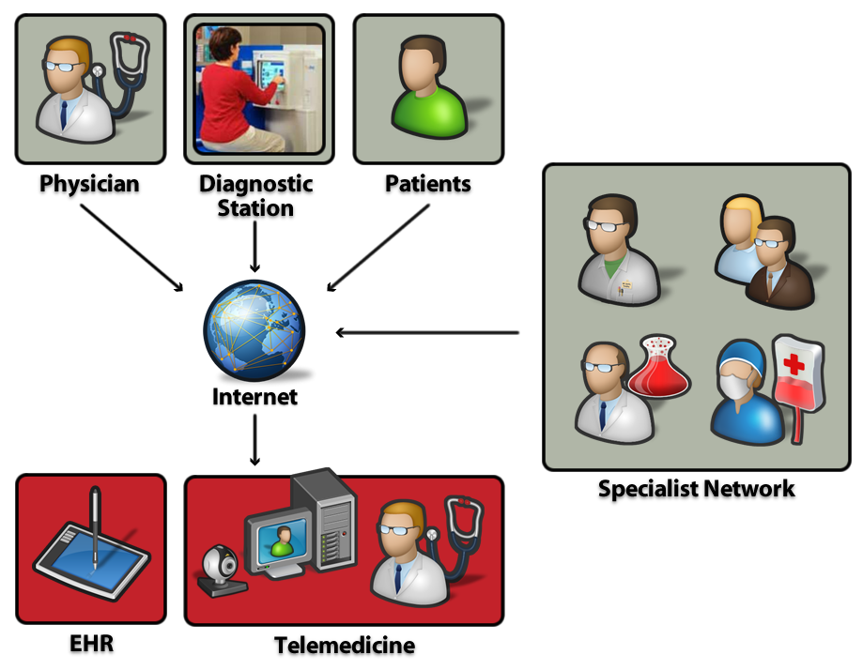
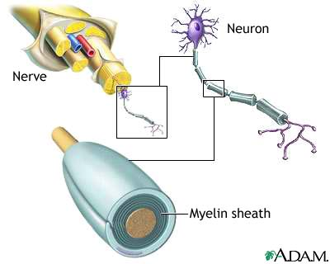
Wireless Biomedical Systems
Wireless
Telemedicine
Wireless
Network
In- Body Wireless Devices
Sensors/monitoring devices
Drug delivery systems
Medical robots
Neural implants
Recovery from
Nerve Damage

Slide 42
Main Points
The wireless vision encompasses many exciting systems and applications
Technical challenges transcend across all layers of the system design.
Cross-layer design emerging as a key theme in wireless.
Existing and emerging systems provide excellent quality for certain applications but poor interoperability.
Standards and spectral allocation heavily impact the evolution of wireless technology

